Slide 1

Combating Financial Crime
A Credit Card Fraud Detection Solution
Uncovering sophisticated fraud patterns to protect consumers and financial institutions
Puja Patidar
Jan 2026

Slide 2
Problem Context, Modeling Approach, and Final Outcome
Problem Context
Modelling Approach
Final Outcome
Credit card fraud is a low-frequency but high-impact risk in digital payments
Extreme class imbalance (~0.5% fraud) renders accuracy-driven and rule-based systems ineffective
Built a full ML pipeline using imbalance-aware techniques
Prioritized PR-AUC and fraud recall over accuracy
Evaluated multiple models under a consistent framework
XGBoost selected as the final model
Achieved strong fraud detection with stable generalization
Model is suitable for deployment with threshold tuning

Slide 3
The Need for Scalable and Adaptive Fraud Detection
Why Traditional Detection Approaches Are Insufficient
Financial Losses
Reputational Damage
Fraud leads to significant monetary losses for banks, merchants, and customers
Repeated fraud incidents erode customer trust and brand credibility
Operational Burden
Evolving Threats
Manual investigations increase cost and response time
Fraud patterns adapt continuously, requiring dynamic detection systems

Slide 4



Who This Solution Is Designed For?
Banking & FinTech Stakeholders
Fraud Analytics Teams
Data Science & Engineering Teams
Reduced financial exposure
Improved platform-level security
Higher-quality alerts
More efficient investigation workflows
Scalable, interpretable ML pipeline
Ability to tune thresholds based on risk appetite

Slide 5
Problem Definition and Objective
Problem
Fraud transactions are extremely rare but highly costly
Accuracy-based models mask poor fraud detection performance
Objective
Maximize the detection of fraudulent transactions
Maintain a manageable false-positive rate for operational feasibility

Slide 6
Data Overview and Core Challenges
Dataset
Core Challenges
1.85 million transactions (2019–2020)
1,000 customers
~800 merchants
Mix of numerical, categorical, temporal, and geographic features
Severe class imbalance (~0.5% fraud)
High variability in customer spending behavior
Fraud patterns driven by interactions across multiple features

Slide 7
Data Quality and Preparation
Key Steps
Outcome
Validated data completeness and consistency
Corrected data types and feature formats
No missing or duplicate records observed
Prepared an analysis-ready dataset for EDA and modelling
Clean and reliable input for downstream modelling

Slide 8
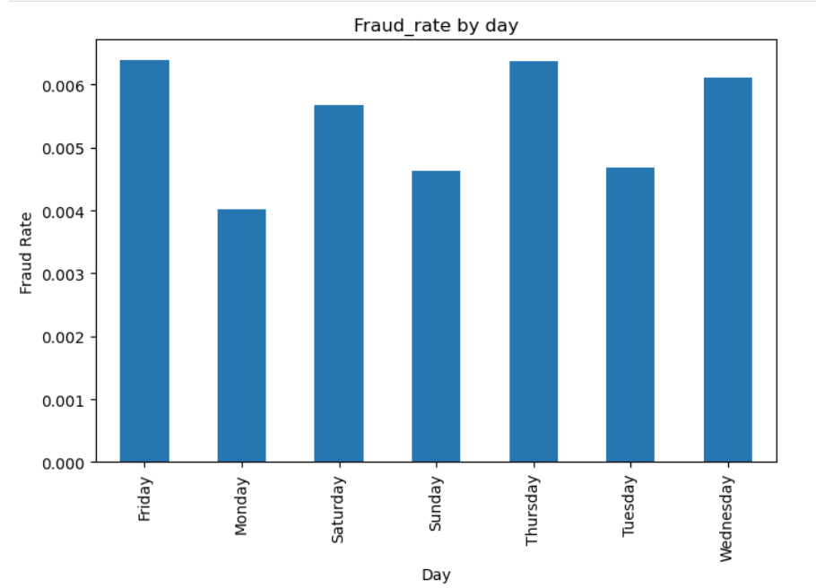
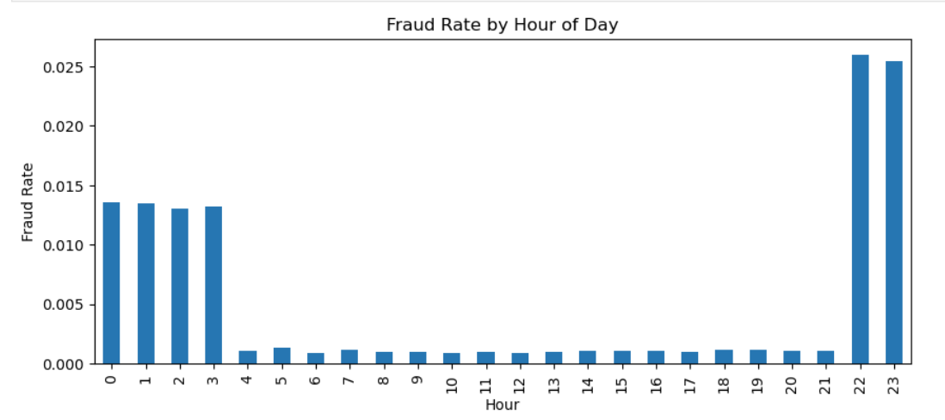
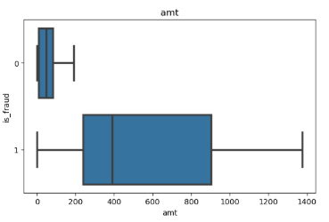
EDA Findings That Informed Modeling Decisions
A. Fraud incidence is higher during night hours
B. Fraud rates peak on Thursday–Friday
C. Fraud transactions show higher variance in amount
These insights directly guided the choice of temporal, behavioral, and deviation-based features

Slide 9
Feature Engineering Strategy
Feature Categories
Temporal: hour, day of week, weekend, night indicators
Behavioral: rolling mean, deviation from recent spend
Velocity: transaction bursts within 24-hour windows
Geographical: customer–merchant distance using Haversine
Monetary: log-transformed transaction amount
Rationale
Fraud emerges from behavioral anomalies, not single attributes

Slide 10
Modelling Strategy and Evaluation Framework
Modelling Approach
Evaluation Metrics
Cross Validation Result
Stratified train–test split and cross-validation
SMOTE applied only on training data to prevent leakage
Consistent preprocessing pipeline across models
Primary: PR-AUC (minority-class focused)
Secondary: Fraud recall
ROC-AUC monitored but not decision-driving
Model | Train PR-AUC | Validation PR-AUC | Train Recall | Validation Recall
Logistic Regression + SMOTE | 0.2075 | 0.2066 | 0.9203 | 0.8536
Decision Tree | 0.2478 | 0.2411 | 0.8759 | 0.8489
Random Forest | 0.734 | 0.6711 | 0.8843 | 0.8585
XGBoost | 0.7742 | 0.7163 | 0.9442 | 0.8705

Slide 11
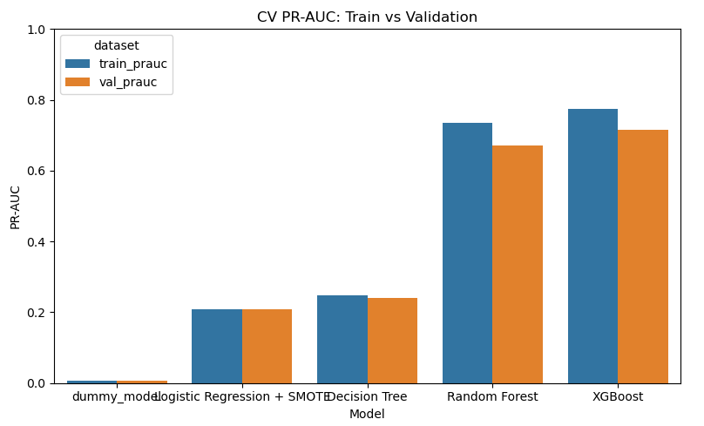
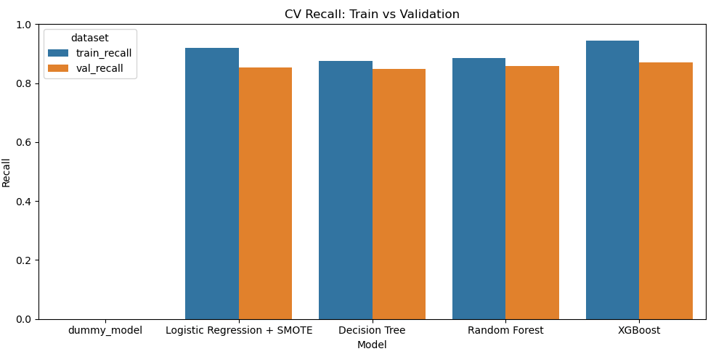
Model Comparison and Final Selection
Model Comparison Summary
Logistic Regression: high recall, weak fraud ranking
Decision Tree: unstable, limited generalization
Random Forest: strong PR-AUC, moderate overfitting
XGBoost: best balance of PR-AUC and recall
Final Model Performance
Validation PR-AUC: 0.716
Fraud recall: 0.87
Controlled train–validation gap
XGBoost achieved the highest validation PR-AUC with strong recall and controlled generalization

Slide 12
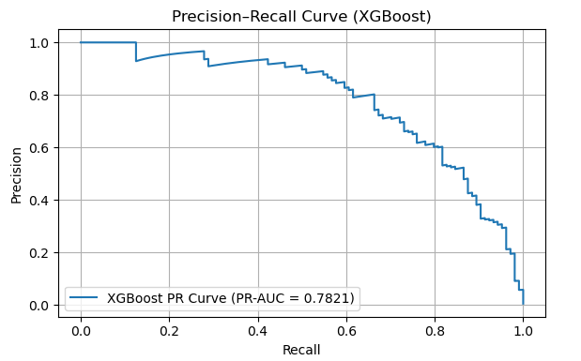
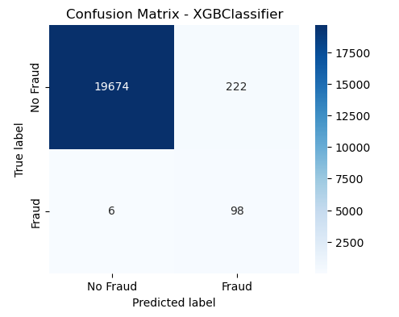

Results obtained from XG-Boost Model
Precision recall area under curve
Confusion matrix
XGBoost achieved the highest validation PR-AUC with strong recall and controlled generalization

Slide 13
From Model Performance to Practical Deployment Impact
Impact
Limitations
Next Steps
The model enables:
Earlier fraud detection
Reduced financial exposure
Configurable thresholds aligned with business risk tolerance
Dependence on sampled data
Synthetic oversampling may not capture all real fraud patterns
Higher recall increases false positives
Incorporate cost-sensitive learning
Build real-time scoring pipelines
Explore temporal and sequential modelling approaches

